Slide 1



Q- eHACK
Traffic Signal Controller Simulator
Team Name:
P. Arjun Singh - 23881A0441 K.Ruchi Raangadh - 23881A0420
I.Abhishek sai - 23881A0402
Department of ECE
Under C-RAISE: Center for Research in Automation and Embedded Systems
Vardhaman College of Engineering, Hyderabad
Date:11/03/2026

Slide 2
Problem Statement:
Urban traffic congestion is increasing rapidly due to growing vehicle population. Traditional traffic signals operate on fixed timers and cannot adapt to real-time traffic conditions.
Target Users / Industry Sector
Smart city infrastructure
Transportation authorities
Why This Problem is Important
Causes traffic congestion and delays
Increases fuel consumption and pollution
Slows emergency response vehicles
Current Challenges
Fixed signal timing regardless of traffic density
No coordination between intersections
Proposed Solution
Develop a Traffic Signal Simulator using QNX RTOS that dynamically adjusts signal timing based on simulated traffic density and system events.
Key Goals
Simulate real-time traffic signal control
Demonstrate real-time scheduling using QNX
Expected Outcomes
Efficient traffic flow simulation
Demonstration of real-time embedded system design

Slide 3
Technical Approach G ǪNX RTOS Relevance
Hardware Components:
Raspberry Pi 4
Raspberry Pi camera rv 1.3
Power supply and connecting wires
Software Components
QNX RTOS
Embedded C programs
Priority based algorithm
Threading Library
Algorithm / Workflow
Input Collection.
Priority Evaluation.
Lane Selection .
Signal Execution (Multithreading)
Cycle Repeat
Why QNX RTOS Was Chosen
Real-time task scheduling
High reliability for industrial systems
Supports multitasking and fast response

Slide 4
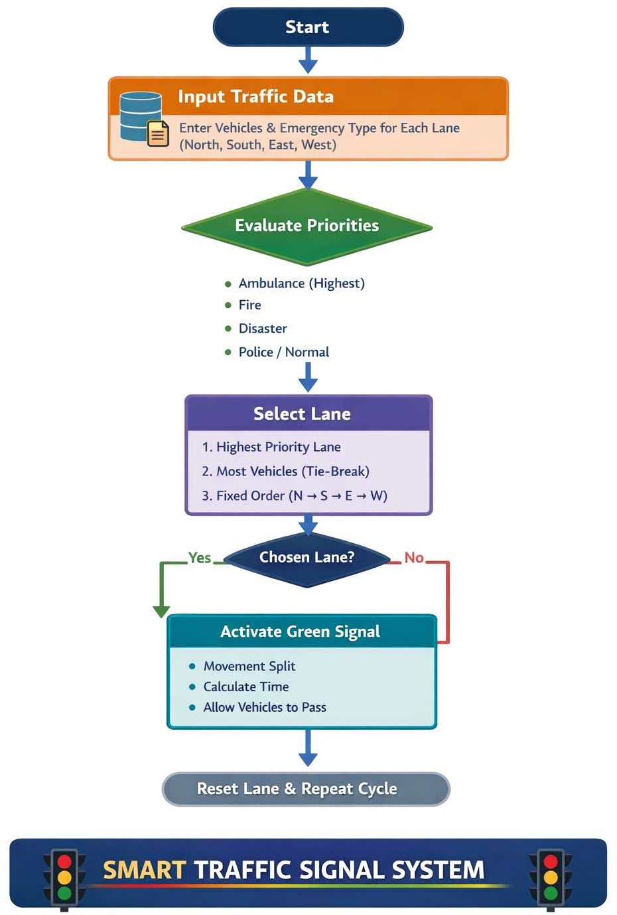


Slide 5
Innovation G Originality
Novelty:
The proposed system simulates a real-time adaptive traffic signal system using QNX RTOS, demonstrating embedded real-time control in urban traffic management.
Uniqueness:
Uses QNX on Raspberry Pi 4 for reliable real-time priority maintenance.
Difference from Existing Systems:
Traditional systems:
Fixed signal timing Proposed system:
Signal changes exactly at the required time
Suitable for real world traffic control
Key Innovation Points:
Real-time traffic density analysis
Priority handling for emergency vehicles
Smart Features:
Emergency vehicle priority override

Slide 6
Impact & Industry Relevance Industry Application
Industry Applications
Smart city traffic management systems
Automotive embedded software development
Urban infrastructure planning
Industries Benefiting
Automotive and mobility sector
Smart city technology providers
Embedded systems companies
Impact Analysis
Improved traffic flow efficiency
Reduced congestion and travel time
Better emergency vehicle movement
Future Scope
Integration with AI-based traffic prediction
Real-time camera-based vehicle detection
Integration with IoT traffic sensors

Slide 7
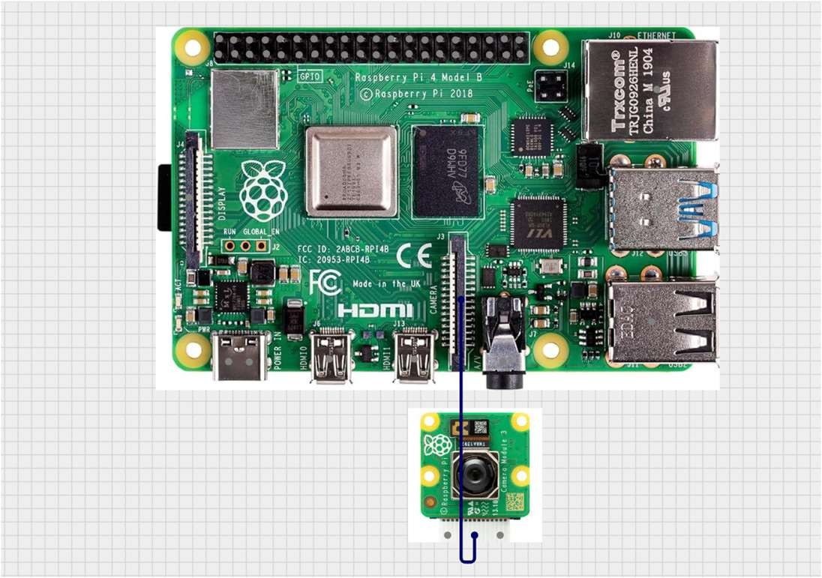
Demo / Implementation
Prototype Demonstration
A working prototype is implemented using Raspberry Pi 4 running QNX to implement priority based traffic signal controller
Working Model Explanation
Raspberry Pi camera rv 1.3 detects the vehicle with the help of A.I in all 4 lanes, and decides the priority. Execution of lane is performed based on the priority scheduled by the algorithm.

Slide 8
Presentation G Documentation
Ǫuality Repository C Documentation GitHub / Code repository Documentation structure
API references Setup instructions Team Contribution Member roles
Development timeline

Slide 9
Conclusion
Summary
This project presents a Traffic Signal Simulator based on QNX RTOS, designed to demonstrate real-time traffic management using embedded system concepts.
Problem Solved
The system addresses the limitations of fixed-timing traffic signals by implementing adaptive signal control based on traffic conditions.
Key Achievements
Real-time signal simulation
Modular architecture using QNX processes
Adaptive signal timing logic
Demonstration of real-time operating system capabilities
Benefits
Improved traffic management simulation
Demonstrates embedded system design principles
Scalable model for smart city traffic systems

Slide 10
Thank You Contact details
Link for repository/ǪR Code of Repository

